Slide 1
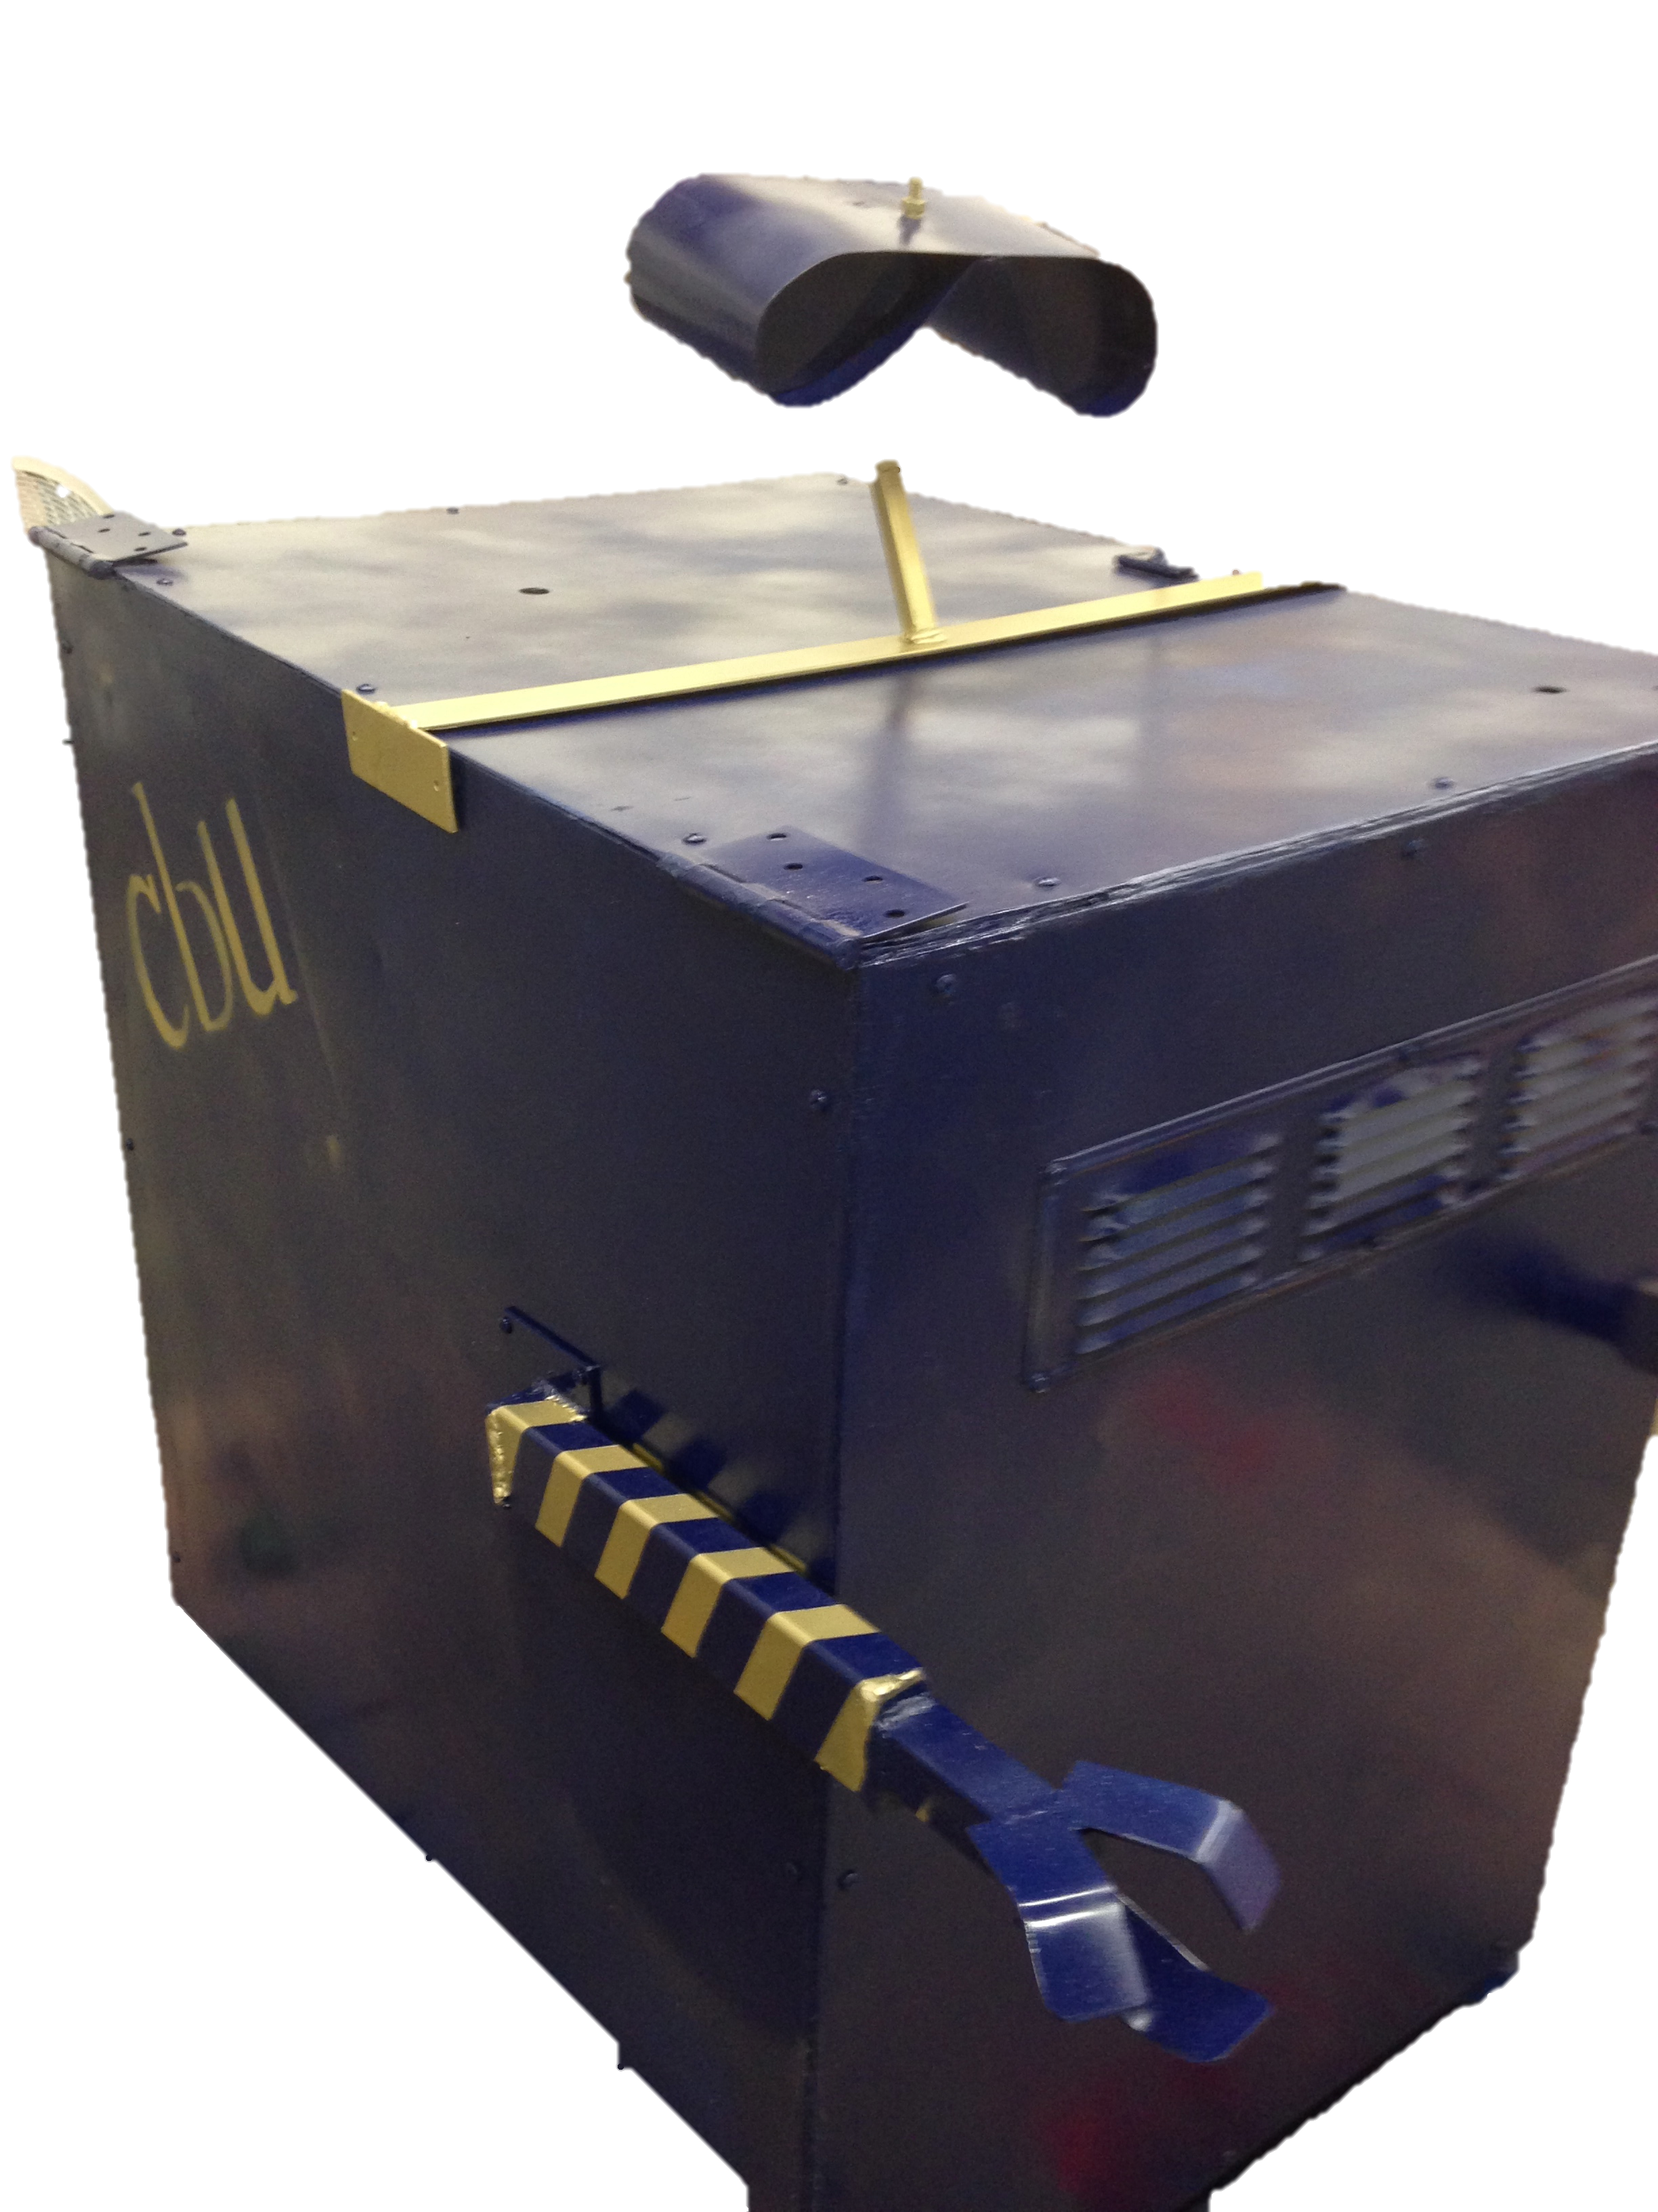
Mobile Solar Power Station
Sneaky Rain
Jordan Rainey • Rocky DeLyon • Jordan Ziegler • Daniel Lombardo • Joshua Hanson

Slide 2
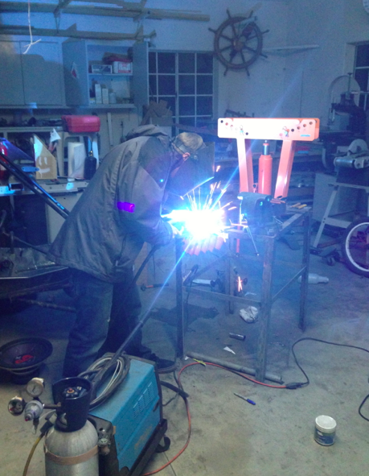
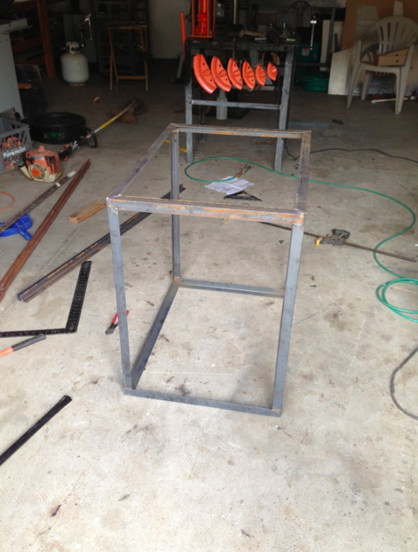
Sleek aluminum design with mild steel angle iron frame.
Welding with a Mig welder(Metal Inert Gas)
Progression of the Frame

Slide 3
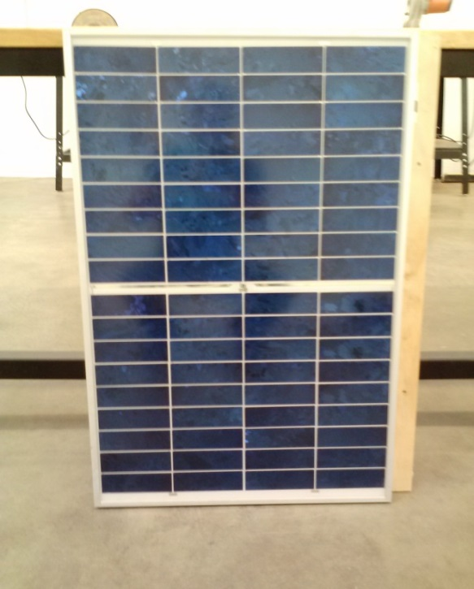
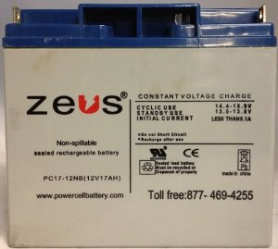
The Solar Panel Produces 50 W of Power and Outputs 16.5 V DC
Rate for power is $.105 per kWh
With an average of 12.16 hours of sunlight it takes 104 days to break even with our $600 budget.
Lead-Acid Battery
Solar Panel
Getting your money back
.05 kW | x | $0.105 | = | $0.00525
 |  | kWh |  | hr
$600 | x | hr | = | 114285.7 hr | x | 1 day | = | 9399 days | or | 25.8 yrs
 |  | $0.00525 |  |  |  | 12.16 hr

Slide 4
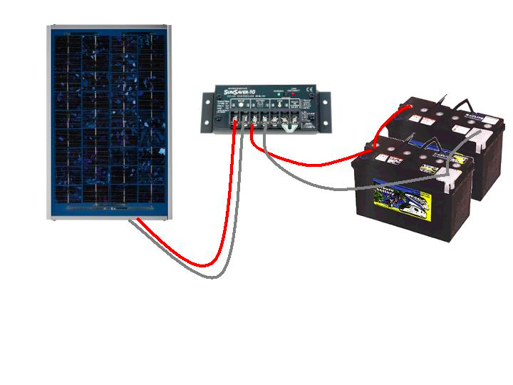
The solar power is used to charge the battery, and the battery is used to power the load.
http://midsummerenergy.co.uk/

Slide 5
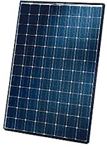
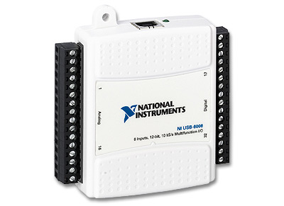
DAQ and labVIEW are essential to reading data from the solar panel.

Slide 6
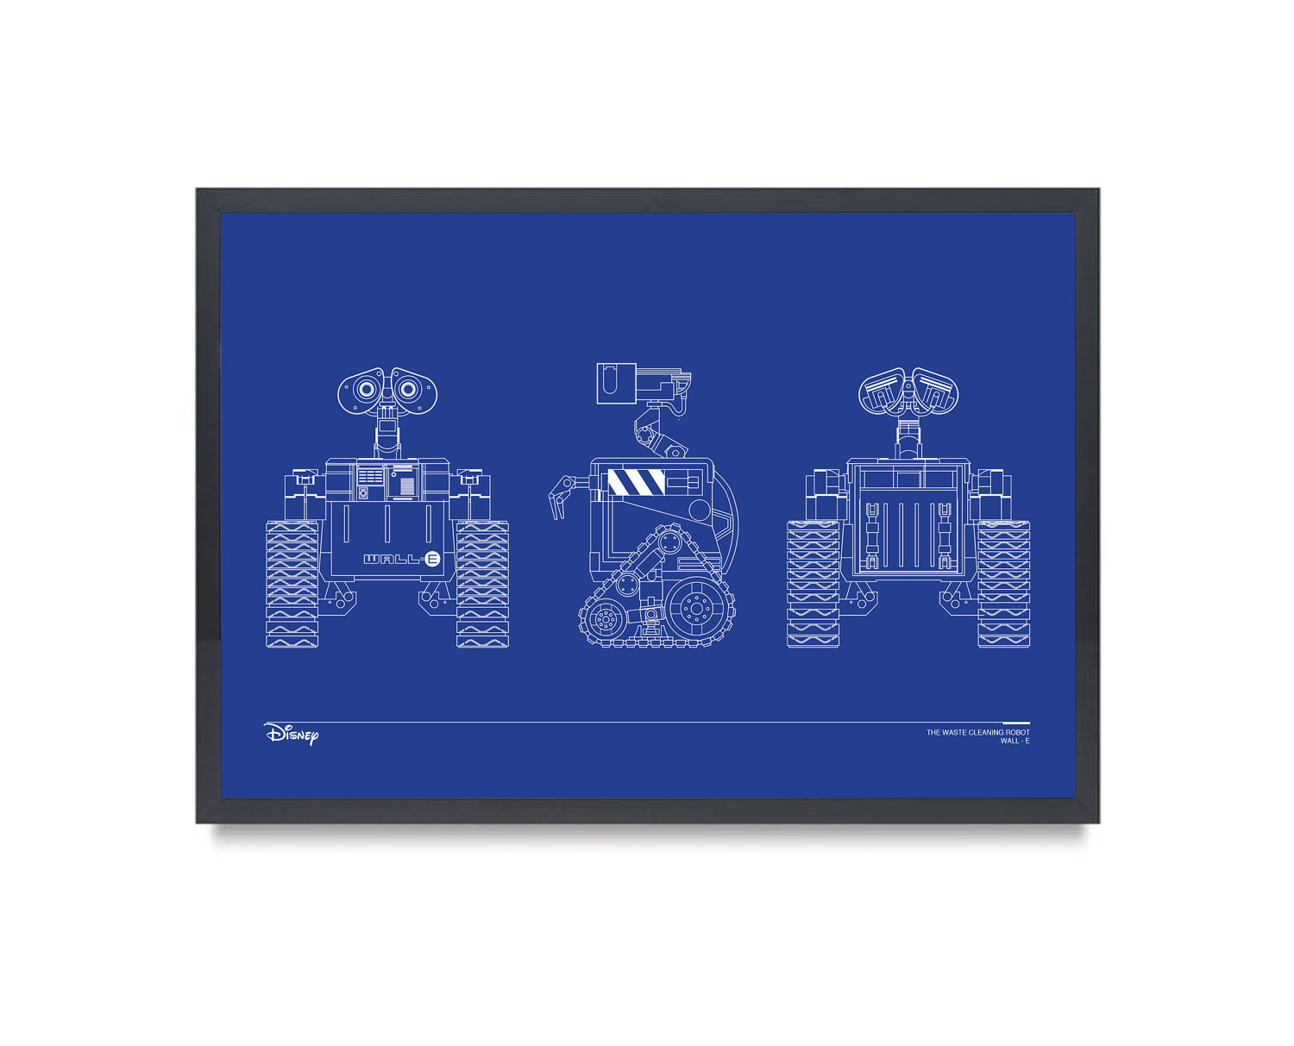
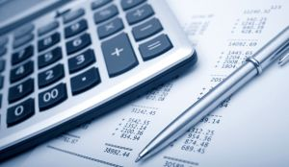


These were crucial lessons in not only design, but also much more.
Budget
Design
Time
Team

